Slide 1
BUSQOM 1080: Data Analysis for Business
Fall 2020
Lecture 3 (8/27)
Professor: Michael Hamilton

Slide 2
Course Specifics
Outline for today:
Misc. Course Updates
Topic: Lists and Matrices [5 Mins Each]
Topic: Dataframes [15 Mins]
Topic: Functions in R [15 Mins]

Slide 3
Topic: Lists
Lists are more general than vectors and can contain multiple data types. We won’t see them too often but they are important to know.
Lists are made using the function list(), and the list's elements can be accessed using brackets.
Example:
> test_list = list(5, “5”)
> test_vec = c(5, “5”)
> c(typeof(test_list[1]), typeof(test_vec[1]))
We can flexibly add and remove from lists as well
Example Cont.:
> test_list[3] = 6 # adds six in the previously undefined sixth position
> test_list[3] = NULL # removes the newly added third element

Slide 4
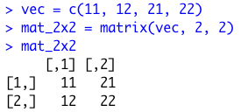
Topic: Matrices
In this class we’ll be interested in data that is primarily multidimensional i.e. each observation corresponds to a row of features. The most natural representation of this is a Matrix.
In R we can build matrices (col by col) out of long vectors using the function matrix(vector, int num_rows, int num_cols).
Example:
We index matrices like vectors, with a comma separating rows and columns e.g. mat_2x2[1,1] = 11, mat_2x2[1,2] = 21
Row 1
Row 2
Co1 1
Co1 2

Slide 5
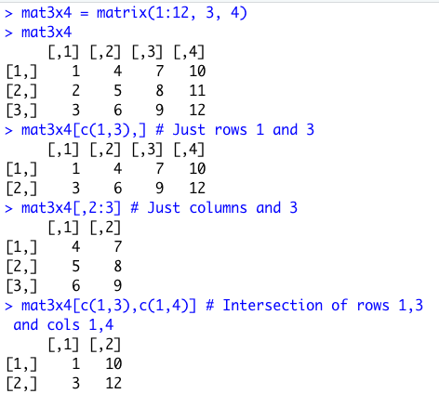
Topic: Matrices
Indexing matrices is slightly more complicated that just vectors. In R we can pass a vector of rows indices in the first component of the brackets and a vector column indices in the second component. R will return the intersection of the specified rows and columns!
We can also specify all rows or all columns by leaving it blank!
Examples:

Slide 6
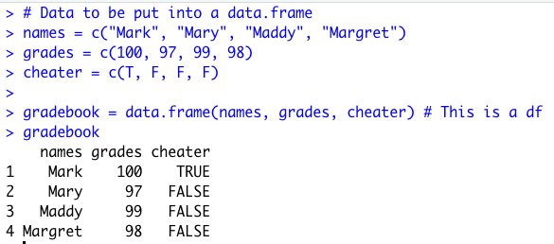
Topic: Dataframes
While matrices are good, they lack several features that are helpful for representing data. The major data structure we’ll use in this class is what’s called a DataFrame (df). DataFrames can be accessed similarly to matrices and can contain multiple data types.
We can make a DataFrame (df) out of (equal length!) vectors using the command data.frame().
Example: Gradebook df
We make a df out of three length-three vectors containing different information about students

Slide 7
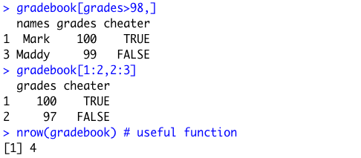
Topic: Dataframes
Accessing Dataframes:
Dataframes inherit column names e.g.
> gradebook$grades # returns vector of grades
> names(gradebook) # returns the names of all the columns
Dataframes can be subsetted like matrices
> gradebook[grades > 98, ]
> gradebook[1:2, 2:3]

Slide 8
Topic: Functions
Finally in R you can write your own functions! This can be immensely helpful but is more involved than previous code we’ve looked at so far.
As a beginner, I highly recommend that each time you write a function, you do it in the R Notebook as its own separate chunk.
The syntax for a function is:
function_name <- function(arg_1, arg_2, ...) {
Function body
}
Note function is a special keyword. This syntax will let you build functions exactly like the ones we’ve been using in R e.g. mean(), or sd().
In general, any time you’re repeating a piece of computation many times a function may we warranted!

Slide 9
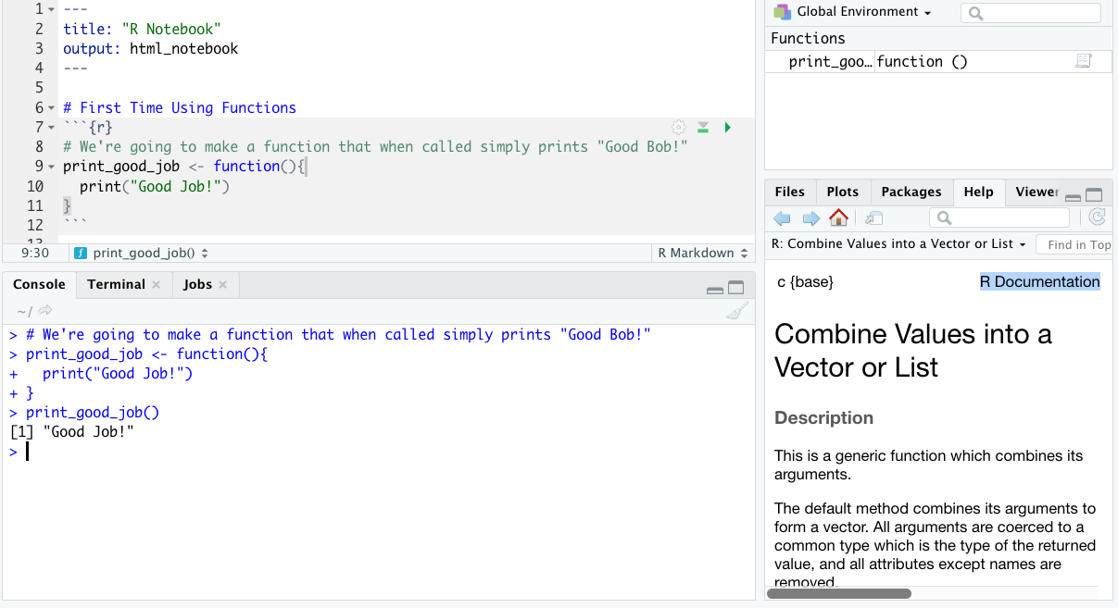
Topic: Functions
Note that once we run (“compile”) our function it is stored in the Env tab just like variables! →
Let’s demonstrate by example.
This is our function, it takes in no arguments
When we run the block from the notebook, it is sent down to the console
<- Here we use our newly defined function. It simply runs the code in the function body!

Slide 10
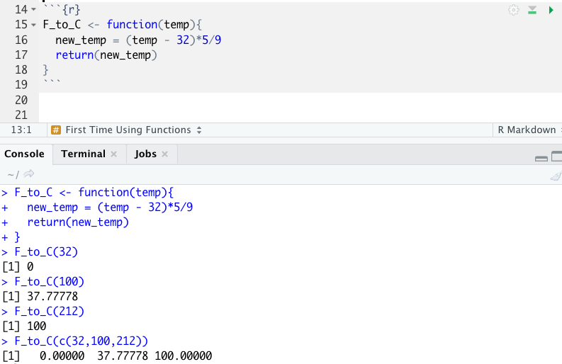
Topic: Functions
Let’s write a function that takes in a temperature (numeric) in F and converts the temperature to C.
This function is take’s an input (of any type!) called temp. temp is the only defined variable for the code inside the function!
This line performs a computation using the input
return() is a special function keyword, it sends it’s argument back to where the function was called
Order of execution goes like:
> F_to_C(32)
1. 32 gets sent to the function F_to_C
2. temp = 32
3. new_temp = (temp - 32)*5/9 # i.e. 0
4. return(new_temp) sends new_temp back to the console

Slide 11
For Next Time
In the zoom session we will do many more examples of writing and using simple functions.
For additional practice with todays topics: Complete swirl lessons (~15 Mins Each)
7: Matrices and Dataframes,
8: Logic,
9: Functions
All in the swirl course “R Programming”.

